Slide 1
HAVE IT
You are awesome

Slide 2
Why HAVE IT?
Prevent procrastination
Achieving long term goals
Have purpose in life, become a better self tomorrow.

Slide 3
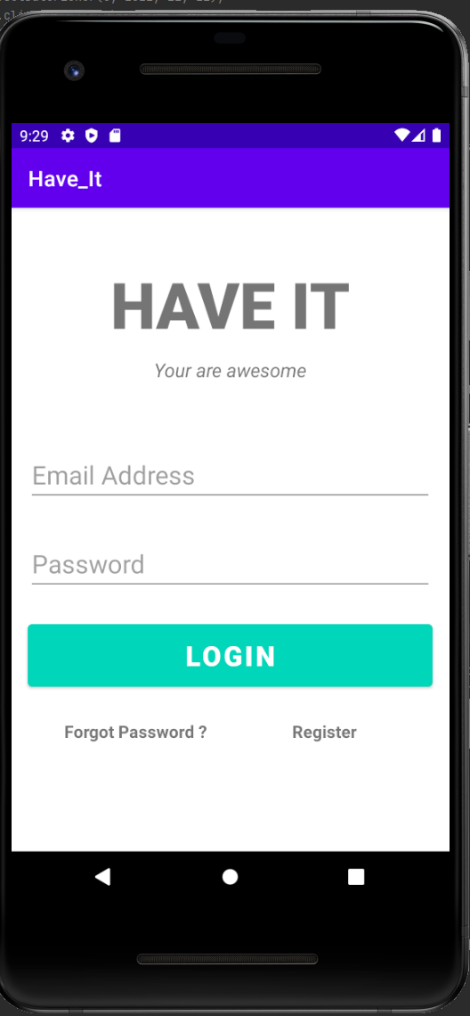
The login page
Clean and concise, one line for email one line for password
Password reset
Registration for new comer

Slide 4
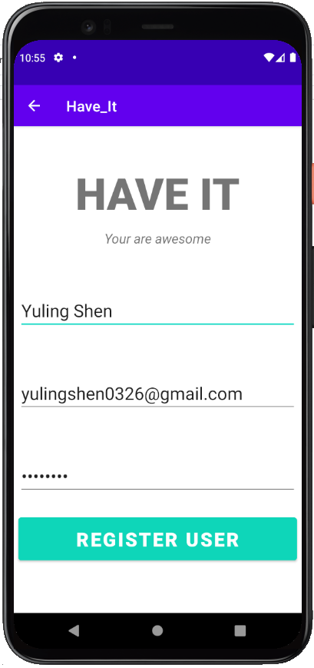
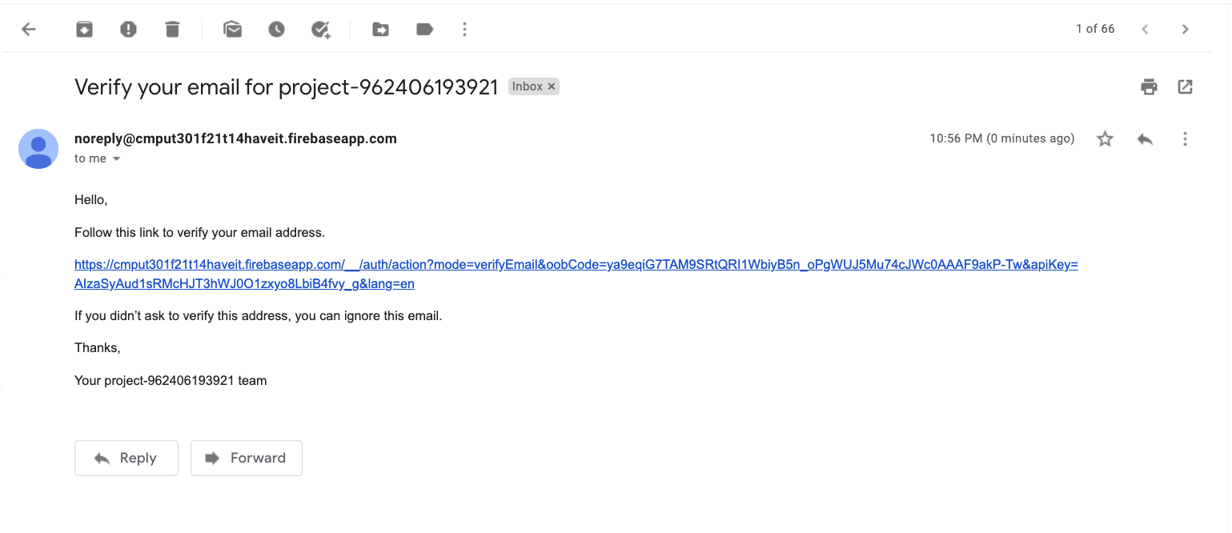
The login page
Authentication for registration done through verification of email
Helps prevent unwanted registration

Slide 5
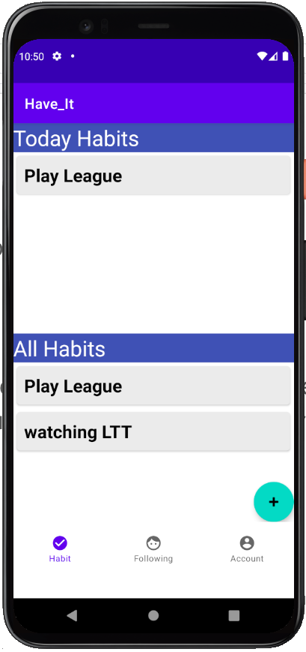
Main page
Today Habit and All Habit in one page, easy to view and edit
List of habits can be reordered at will
Selection bar at the bottom of the screen; easy access To followers, your account and the individual you are following.

Slide 6
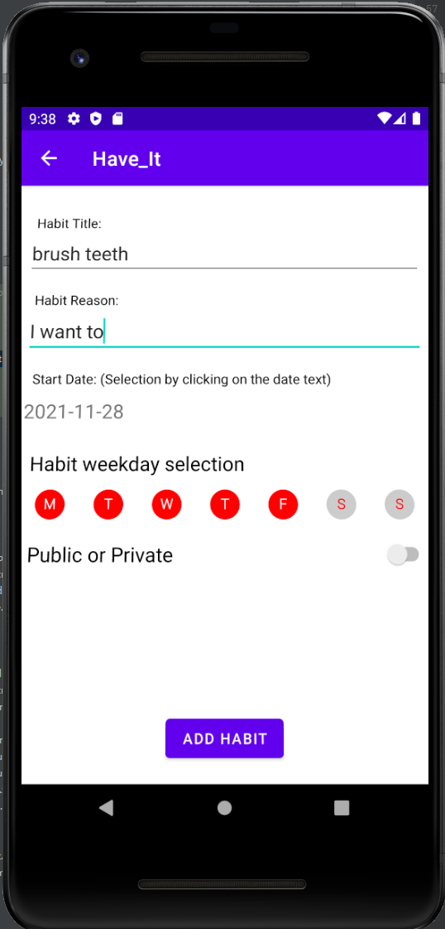
Habit adding page
Calendar for date selection
Security feature, you can make your habit private
Habit weekday selection for what day you want to do it

Slide 7
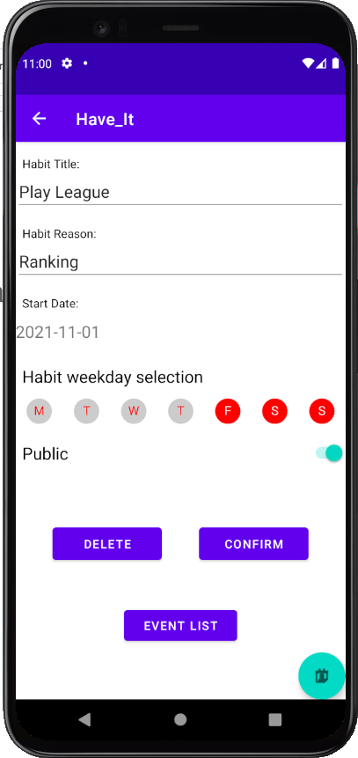
Habit viewing page
Similar as the adding page
Edit or delete the habit
View the event or the visual indicator of the habit

Slide 8
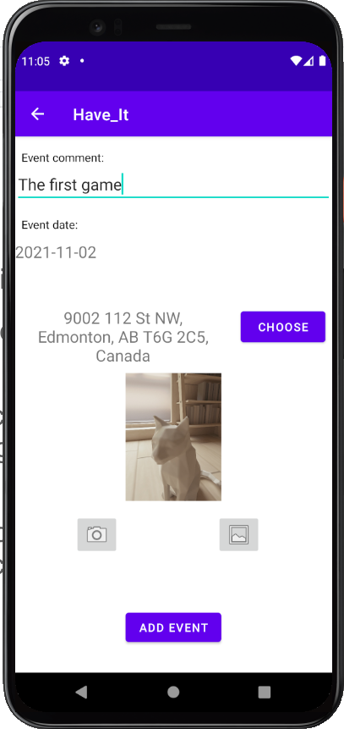
Habit Event
User can add details to their habit event
Event comment
Event date
Optional location
Optional photo
Location retrieved using google map, default as current location
Photo can be taken by camera or select by gallery
Similar page for view existing event, with capability of editing and deleting

Slide 9
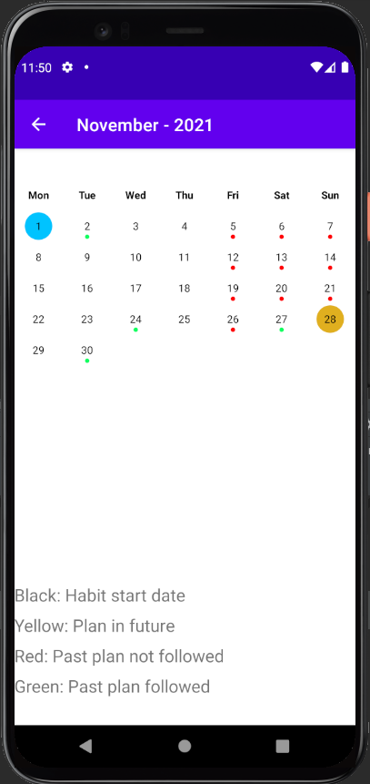
Visual indicator
Easy to view, intuitive indicator of the month
Slide to change between months

Slide 10
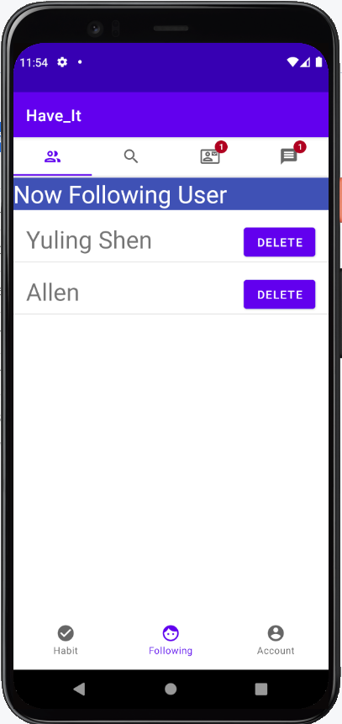
Following page
Tab bar on the top to switch between pages
View a full list of followings, click to see their habits
Search for users to send request to
Notification for requests received and received reply for requests sent

